Slide 1
SMART DUSTBIN

Slide 2

Our team
ANISHU NACHHIRING RAI
NEELISHA SHRESTHA
SRIJANA LIMBU

Slide 3
Table of contents
01
02
03
04
Design specification
Introduction
Objective
Components used in making the smart dustbin
Short introduction about the presentation.
Objective of the project
05
06
Working Concept
Conclusion
Scope/future plans
Let us know about how does this smart dustbin works
Scope of the project in future

Slide 4

01
Introduction
Arduino based system
Provide sensor based collection to the garbage collection
Planning for enabling collection for garbage data management.
Ensure the greenish environment for “Garbage Management System” for Nepal.

Slide 5
OBJECTIVES
To provide a more effective and efficient waste management solution
To provide an efficient and convenient waste disposal system
4
2
The salient feature of this method is to build a clean environment and to empower the“ Garbage Management” Mission.
1
3
To promote sustainable waste management practices

Slide 6
DESIGN SPECIFICATION
SG90 Micro servo motor
ARDUINO UNO
ULTRASONIC SENSOR HC- SR04

Slide 7
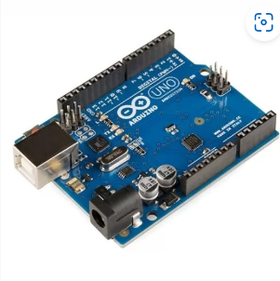
Arduino Uno
Open-source microcontroller board based on the processor ATmega328P
It has 14 digital input/output pins
Contains everything needed to support the microcontroller.
Just plug it into a computer with a USB cable with adapter to get started with it

Slide 8
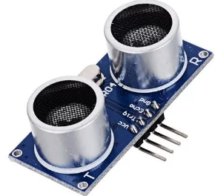
Ultrasonic Sensor HC-SR04
HC-SR04 is an ultrasonic distance sensor used for measuring the distance at which an object is located.
It has two parts, one emits the ultrasound sonar to measure the distance to an object.
The other part is the receiver which listens for the echo

Slide 9
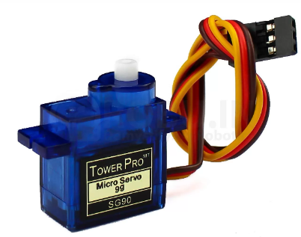
SG90 Micro servo motor
The micro servo is a light, good quality and very fast servo motor.
designed to work with most radio control systems.
The SG90 mini servo with accessories is perfect for remote-controlled products.
.

Slide 10
Working principal
Uses an ultrasonic sensor HC-SR04 to detect objects in front.
sends the signals to Arduino Uno.
understands the signal
sends a signal to the Servomotor
opens the flap on top of the dustbin.
open the race for only 5 seconds automatically closes.

Slide 11
SCOPE
2
1
Public spaces: Smart dustbins can be installed in public spaces such as parks, shopping malls.
Smart cities: Smart dustbins can be a crucial component of smart city
Residential areas: Smart dustbins can be used in residential areas
Commercial areas: Smart dustbins can be installed in commercial areas.
3
4

Slide 12
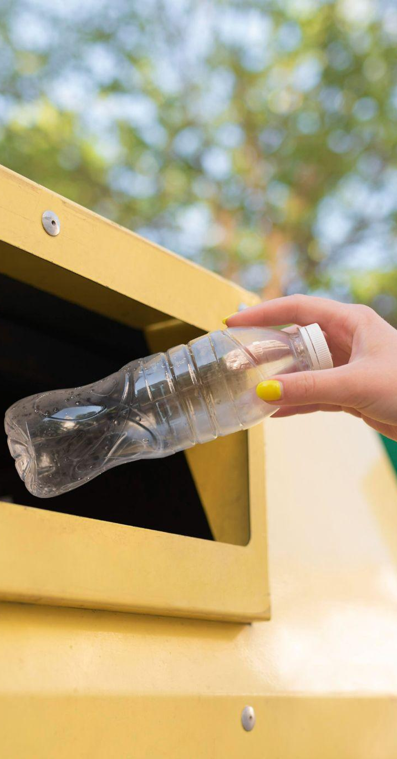
Conclusion

Slide 13
THANK YOU!

Slide 14
ANY
QUESTIONS?

